Slide 1

SPC: Subspace Predictive Control
Presentation for the course Adaptive Learning, Estimation and Supervision of dynamical systems (ALES)
Computer science engineering
Students
Mazzoleni Gabriele - 1079514
Comandatore Gaetano- 1090952
A.Y. 2025/2026

Slide 2
Selected paper
The following presentation as an analysis and implementation of the contents of “SPC: Subspace Prediction Control”, by Wouter Favoreel, Bart De Moor and Michel Gevers
This paper aims to “combine Subspace Identification and Model Predictive Control methods in a very elegant way to form a numerically robust and easily implementable control/identification algorithm”.

Slide 3
Context of application
Subspace System Identification and Model Predictive Control are two widely studied and applied methods to solve two problems that are usually considered separate: these problems being system identification and system control.
The SPC method aims to replace the system identification step and the calculation of the controller parameters with a QR decomposition followed by an SVD decomposition of a matrix that is constructed using known inputs and outputs only, combining the two solution to two problems into an elegant solution for one big problem.

Slide 4
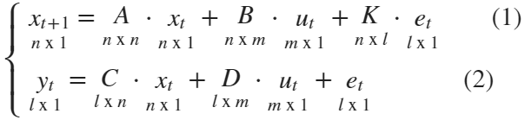



System model
The paper considers a LTI system of the form:
Where:
are the system inputs
are the system outputs
are the system states
is the noise sequence
only yt and ut are known

Slide 5
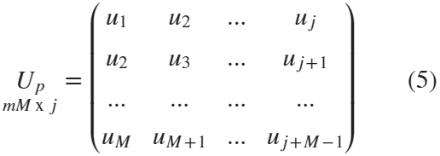
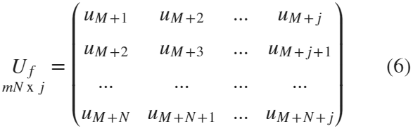

Block Hankel matrices definition
The SPC algorithm starts by defining the block Hankel matrices for inputs, outputs and noise, assuming k= N+M+j total samples for all three signals:
We define the matrices in the same way.
p represents “past” matrices, with M being the number of “past” data points
f represents “future” matrices, with N being the number of “future” data points

Slide 6
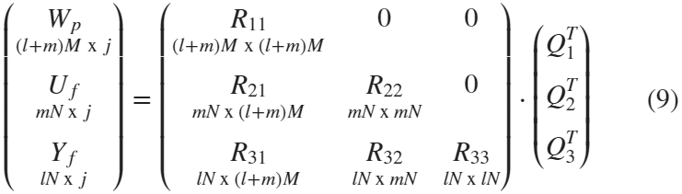



Subspace solution – Step 1
We can solve the subspace problem using QR decomposition like so
And then computing the matrix
and thus:

Slide 7
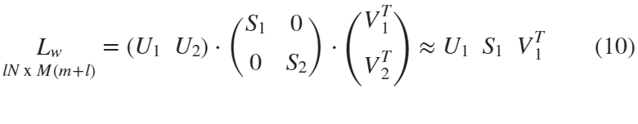




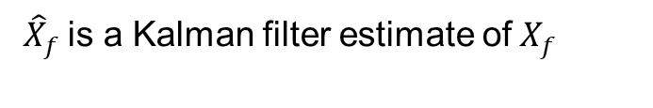
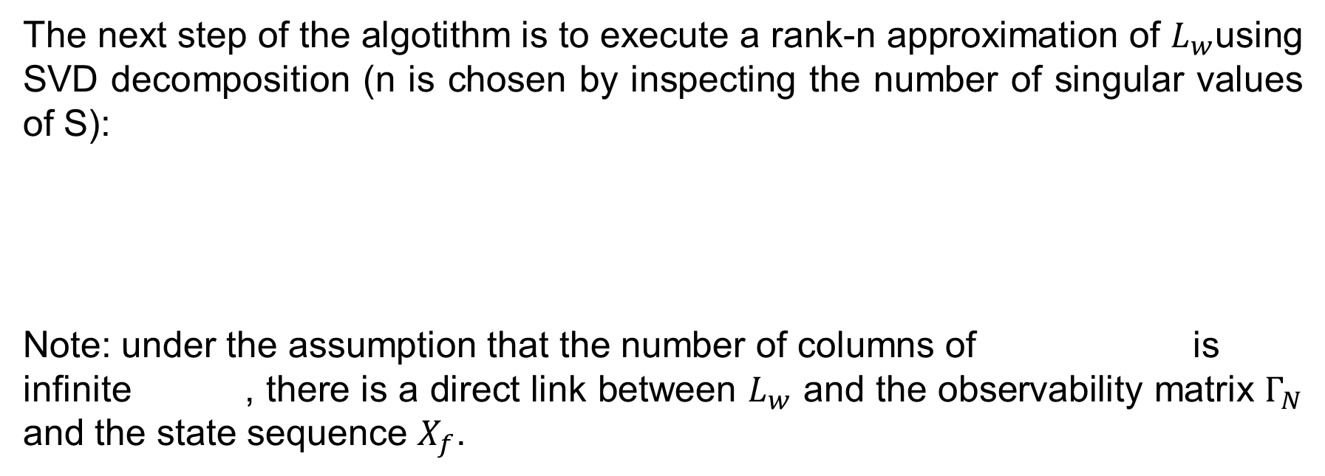
Subspace solution – Step 2
The next step of the algotithm is to execute a rank-n approximation of $L_{w}$using SVD decomposition (n is chosen by inspecting the number of singular values of S):
Note: under the assumption that the number of columns of is infinite , there is a direct link between $L_{w}$ and the observability matrix $Γ_{N}$ and the state sequence $X_{f}$.
${\hat{X}}_{f}$is a Kalman filter estimate of$X_{f}$

Slide 8

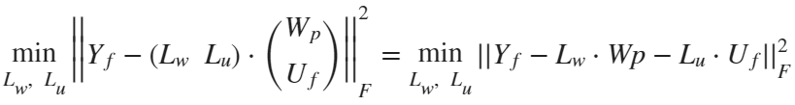
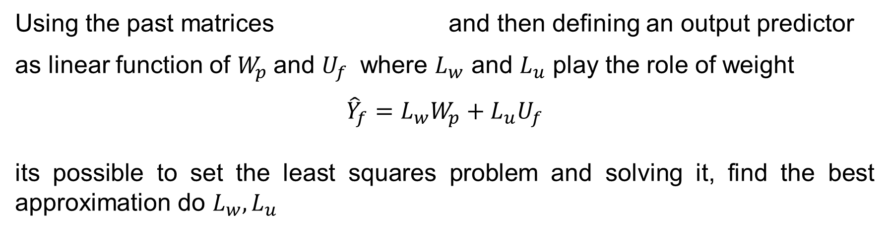
Proposed solution –
Defining the predictor and LS problem
Using the past matrices and then defining an output predictor
as linear function of $W_{p}$and $U_{f}$ where $L_{w}$ and $L_{u}$ play the role of weight
$${\hat{Y}}_{f}=L_{w}W_{p}+L_{u}U_{f}$$
its possible to set the least squares problem and solving it, find the best approximation do $L_{w}, L_{u}$

Slide 9
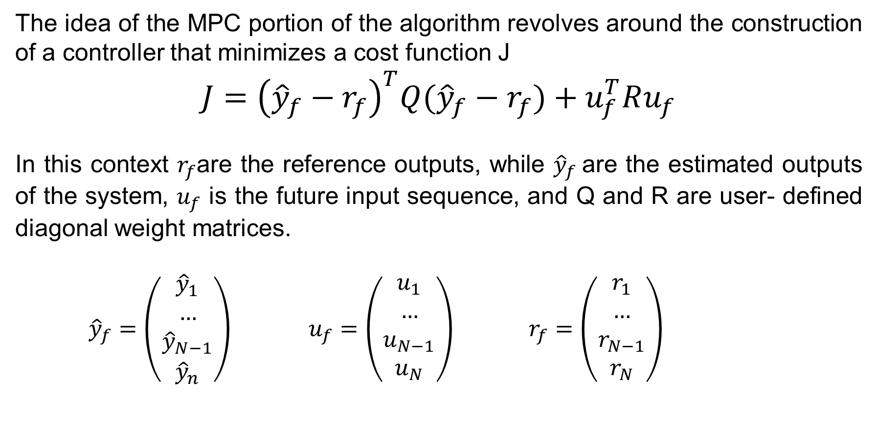
Proposed solution – MPC problem
The idea of the MPC portion of the algorithm revolves around the construction of a controller that minimizes a cost function J
$$J={\left({\hat{y}}_{f}−r_{f}\right)}^{T}Q({\hat{y}}_{f}−r_{f})+u_{f}^{T}Ru_{f}$$
In this context $r_{f}$are the reference outputs, while ${\hat{y}}_{f}$are the estimated outputs of the system, $u_{f}$ is the future input sequence, and Q and R are user- defined diagonal weight matrices.
${\hat{y}}_{f}=\left(\begin{aligned}{\hat{y}}_{1} \\ … \\ {\hat{y}}_{N−1} \\ {\hat{y}}_{n}\end{aligned}\right)$ $u_{f}=\left(\begin{aligned}u_{1} \\ … \\ u_{N−1} \\ u_{N}\end{aligned}\right)$ $r_{f}=\left(\begin{aligned}r_{1} \\ … \\ r_{N−1} \\ r_{N}\end{aligned}\right)$

Slide 10
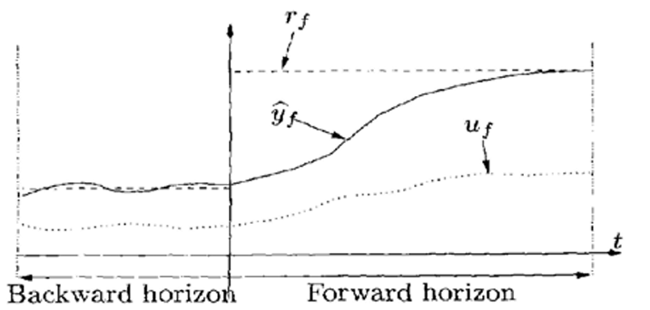
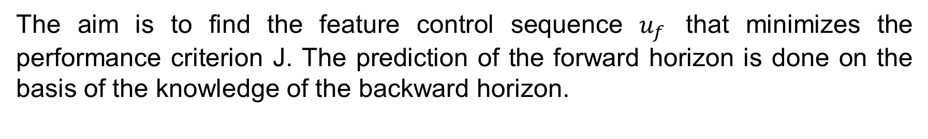
Proposed solution – Principle of MPC
The aim is to find the feature control sequence $u_{f}$ that minimizes the performance criterion J. The prediction of the forward horizon is done on the basis of the knowledge of the backward horizon.

Slide 11
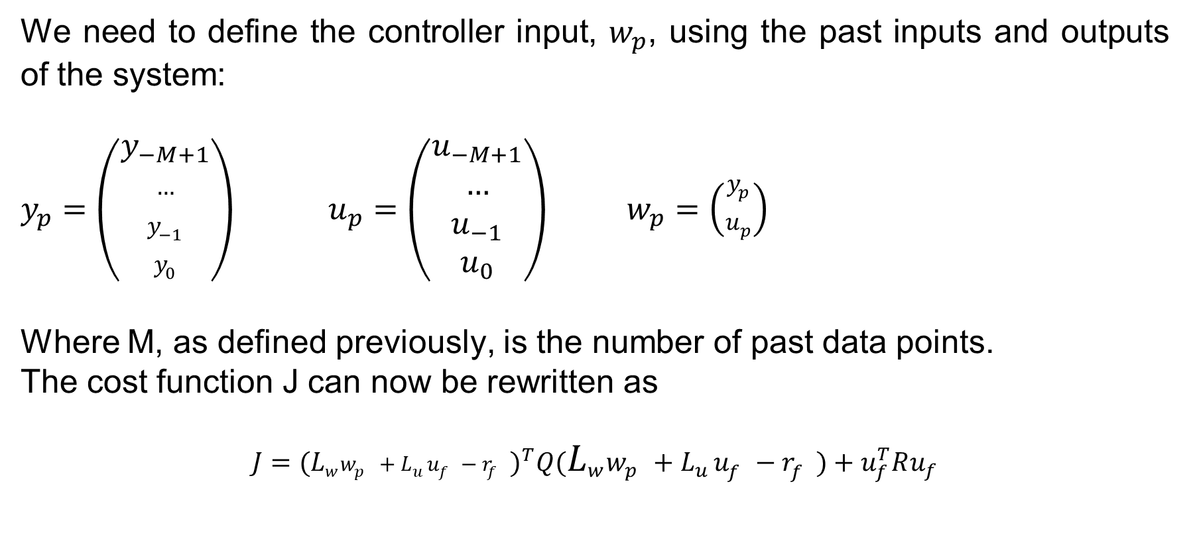
Proposed solution – Control step 1
We need to define the controller input, $w_{p}$, using the past inputs and outputs of the system:
$y_{p}=\left(\begin{aligned}y_{−M+1} \\ … \\ y_{−1} \\ y_{0}\end{aligned}\right)$ $u_{p}=\left(\begin{aligned}u_{−M+1} \\ … \\ u_{−1} \\ u_{0}\end{aligned}\right)$ $w_{p}=\left(\begin{aligned}y_{p} \\ u_{p}\end{aligned}\right)$
Where M, as defined previously, is the number of past data points.
The cost function J can now be rewritten as
$$J={(L_{w}^{}w_{p}^{}+L_{u}^{}u_{f}^{}−r_{f}^{})}^{T}Q(L_{w}^{}w_{p}^{}+L_{u}^{}u_{f}^{}−r_{f}^{})+u_{f}^{T}Ru_{f}$$

Slide 12
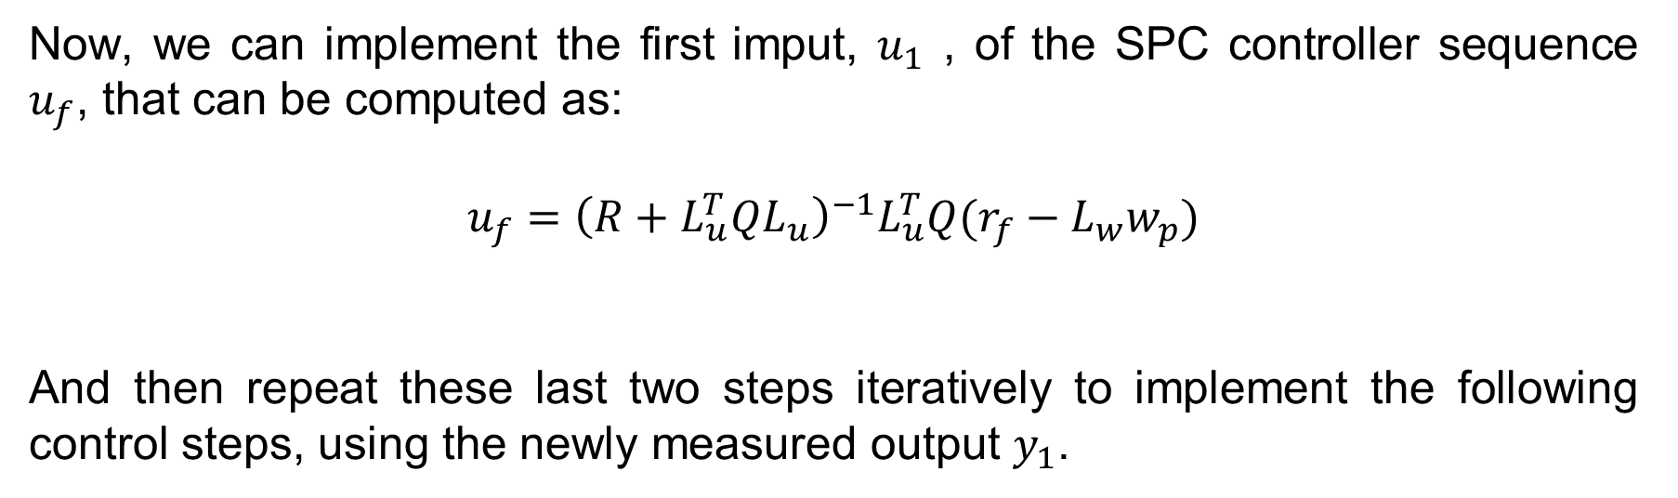
Proposed solution – Control step 2
Now, we can implement the first imput, $u_{1}$ , of the SPC controller sequence $u_{f}$, that can be computed as:
$$u_{f}={\left(R+L_{u}^{T}QL_{u}\right)}^{−1}L_{u}^{T}Q(r_{f}−L_{w}w_{p})$$
And then repeat these last two steps iteratively to implement the following control steps, using the newly measured output $y_{1}$.

Slide 13
Practical implementation –
a

Slide 14
Results
a

